Slide 1
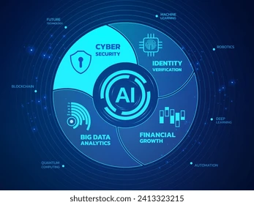
AI in Business
Applications, Benefits, and Future Prospects
Explore the basics of AI

Slide 2
Key Applications of AI
Where AI is Making an Impact
AI Integration in Business Functions
Customer Service: Chatbots and virtual assistants provide 24/7 support and personalized interactions.
Marketing & Sales: AI-driven platforms analyze customer data to create highly personalized campaigns and product recommendations, as seen with companies like Amazon.
Operations & Logistics: Optimizing supply chains, managing inventory, and predicting maintenance needs to reduce costs and increase efficiency.
Data & Analytics: AI can process massive datasets to provide actionable insights for strategic decision-making.
Business Function | AI Application | Example Company
Customer Service | Chatbots & Virtual Assistants | Boost.ai
Finance | Fraud Detection & Risk Management | Financial institutions
Supply Chain | Route Optimization | DHL
HR | Resume Screening & Talent Acquisition | N/A

Slide 3
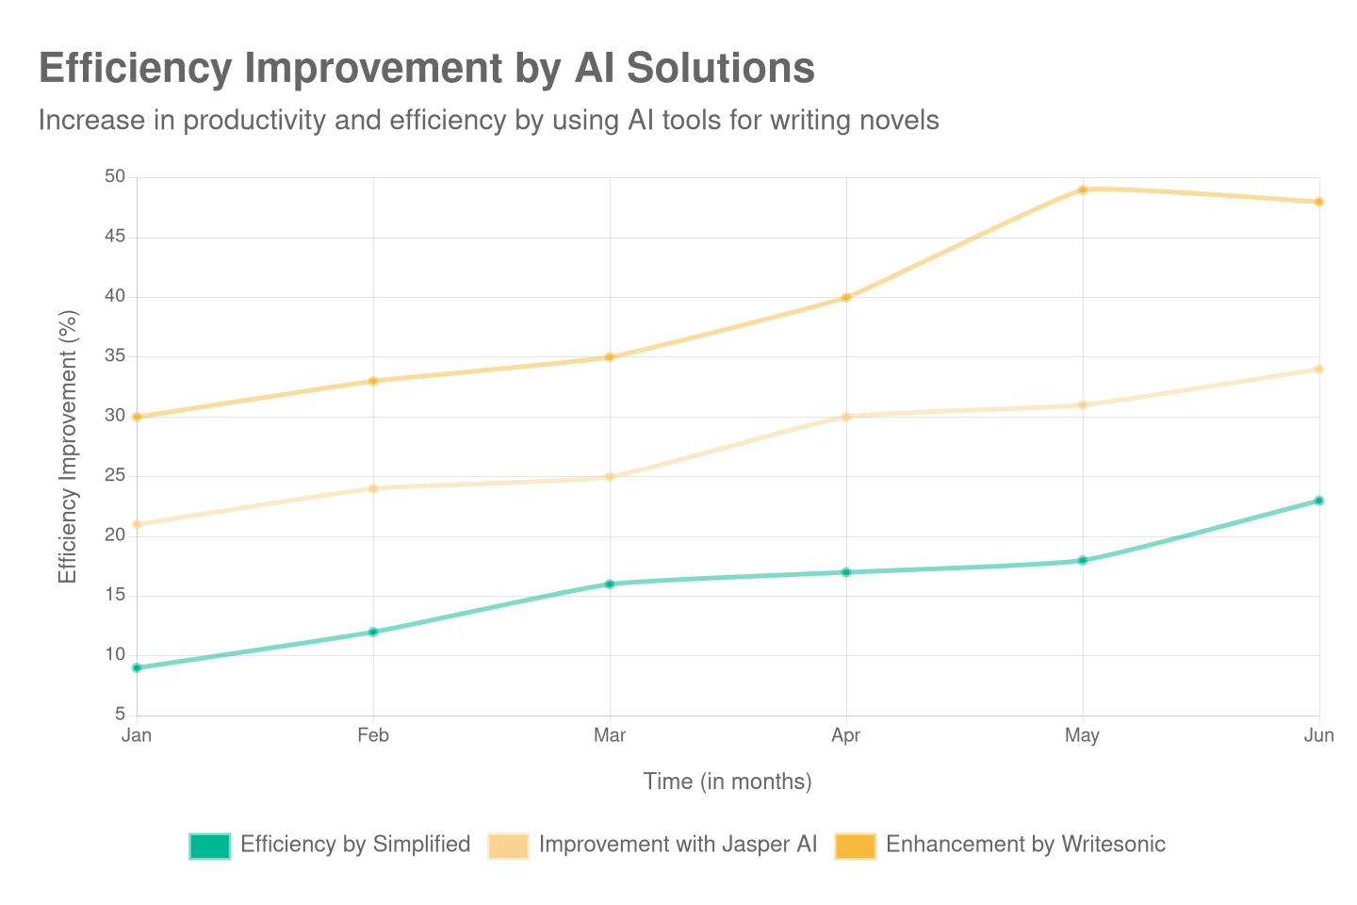
The Benefits of AI Adoption
The Strategic Advantages:
Increased Efficiency & Productivity: Automates repetitive tasks, freeing up employees for more strategic work. A recent survey showed that workers save an average of 55 minutes per day using AI tools.
Enhanced Decision-Making: Provides real-time, data-driven insights to help leaders make more informed decisions.
Cost Reduction: Optimizes processes, reduces human error, and predicts maintenance needs to lower operational costs.
Improved Customer Experience: Delivers highly personalized experiences and faster service, leading to higher customer loyalty.

Slide 4
Future Prospects and Trends
Future AI Trends
The Future is Now:
Responsible AI: A growing focus on ethical frameworks, governance, and addressing concerns like data privacy and algorithmic bias.
AI Agents: Autonomous systems capable of managing complex, end-to-end tasks without constant human oversight.
Hyper-Personalization: The use of AI to create extremely detailed, tailored experiences for individual customers in sectors like retail and finance.
AI Democratization: The rise of no-code and low-code AI platforms, making the technology accessible to a wider range of businesses and non-technical users.
Trend | Description
Multimodal AI | AI that can understand and generate content across multiple formats, like text, images, and video.
Advanced Generative AI | More sophisticated models that can create high-quality, creative content.
AI for Sustainability | AI used to optimize energy consumption and manage resources for environmental goals.

Slide 5
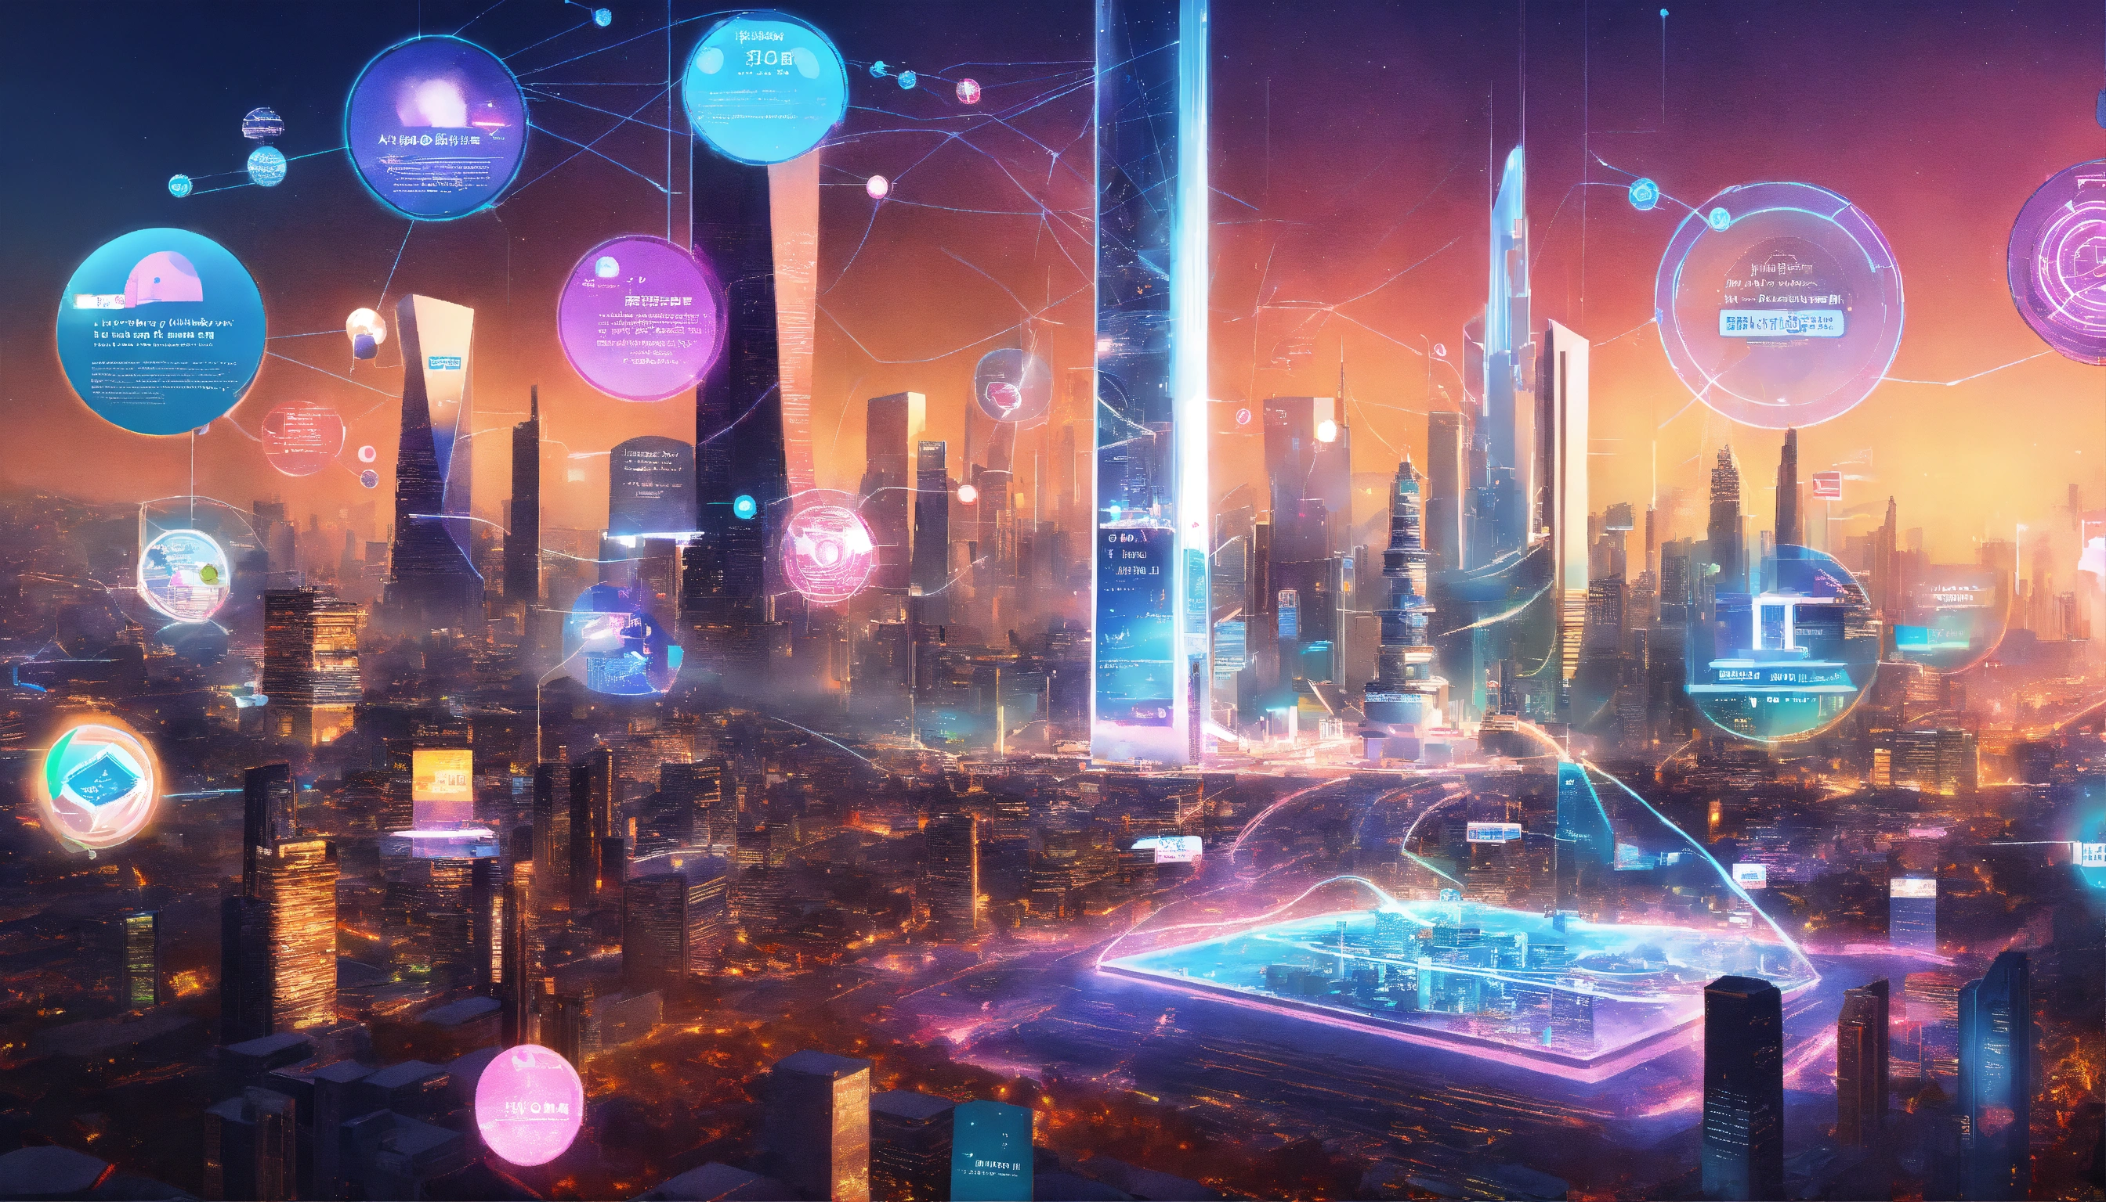
The Path Forward
Staying Competitive in an AI-Driven World
Embrace a culture of continuous learning and upskilling for employees.
Start with small-scale AI projects to demonstrate value and build confidence.
Prioritize data governance and ethical considerations from the outset.
Don't be afraid to experiment and be an early adopter.
Read PwC's 2025 AI Business Predictions

